Slide 1
PROJECT
By: Under the Guidance of :
PRASHANT KUMAR Dr. Mula Malyadri
HU21CSEN0101908 Assistance Professor,CSE,GST,Hyd

Slide 2
INTRODUCTION
Internship Name : Data Science Master Virtual Internship
Internship Organization: EduSkills Foundation supported by Altair.
Project Platform: Altair AI Studio (formerly RapidMiner Studio).
Duration: [April 2024 - June 2024]

Slide 3
Overview
Objective:
To gain hands-on experience with data science tools and techniques using Altair AI Studio.
To understand and apply various data science methodologies, including data preparation, modeling, and analysis.Objective:
Project focus:
Importing, visualizing, and analyzing datasets using Altair AI Studio.
Building processes to generate correlation matrices, perform data aggregation, and conduct linear regression analysis.

Slide 4
ALTAIR AI STUDIO
Formerly known as RapidMiner Studio.
An approachable, end-to-end data science platform.
Designed for users of all levels, from beginners to professionals.

Slide 5
ALTAIR AI STUDIO
Key Features:
User-Friendly Interface: Intuitive drag-and-drop functionality.
Comprehensive Tools: Supports data preparation, modeling, and deployment.
Robust Community Support: Extensive documentation, tutorials, and active user forums.

Slide 6
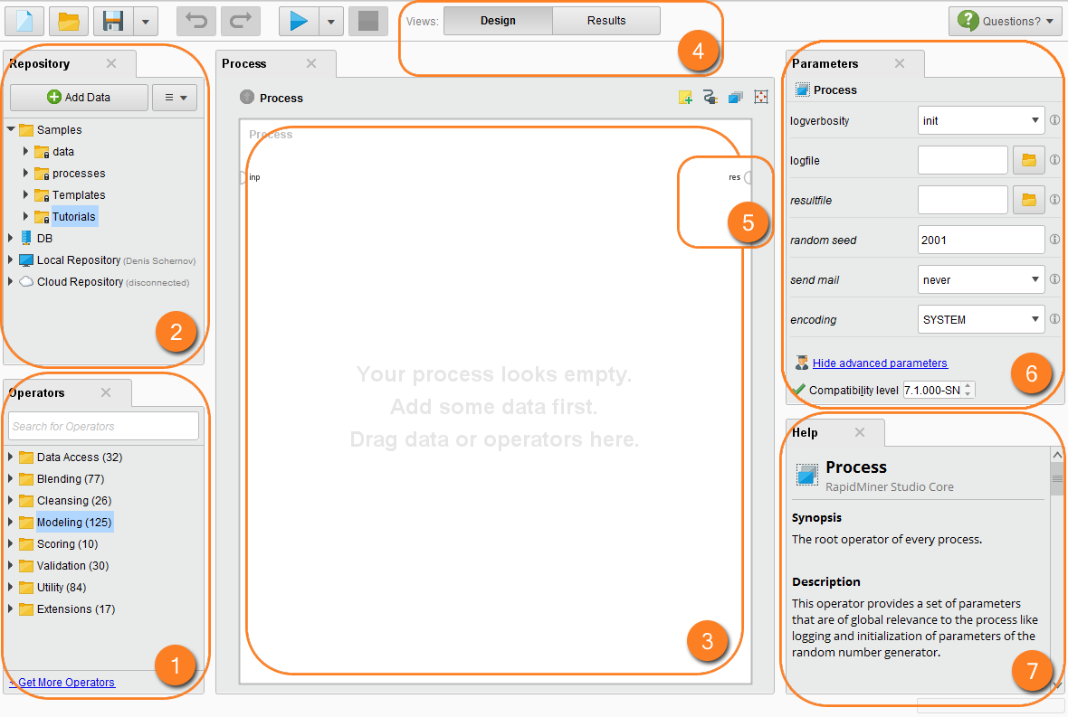
ALTAIR AI STUDIO
Home page

Slide 7
Number | Name | Description
1 | Operators | Building blocks used to create Altair AI Studio processes.
2 | Repository | Storage within Altair AI Studio for data and processes.
3 | Process panel (Main Process) | Working area for building processes.
4 | Views | Work area for accessing specific functionality.
5 | Ports | Input and output mechanisms for operators and processes. See the listing of port abbreviations and meanings.
6 | Parameters | Settings that modify operator behavior.
7 | Help | Context-sensitive help for selected operator.
1, 2, 3, 6, 7 | Panels | Tools available to a view.

Slide 8
ALTAIR AI STUDIO
Applications:
Learning: Ideal for understanding data science modeling and application techniques.
Teaching: Perfect for university courses or online education.
Research: Suitable for academic or project-based research.
Industry Evaluation: Evaluate the software for industrial or commercial projects.

Slide 9
Project (datasets)
https://www.kaggle.com/datasets/klkwak/toyotacorollacsv

Slide 10
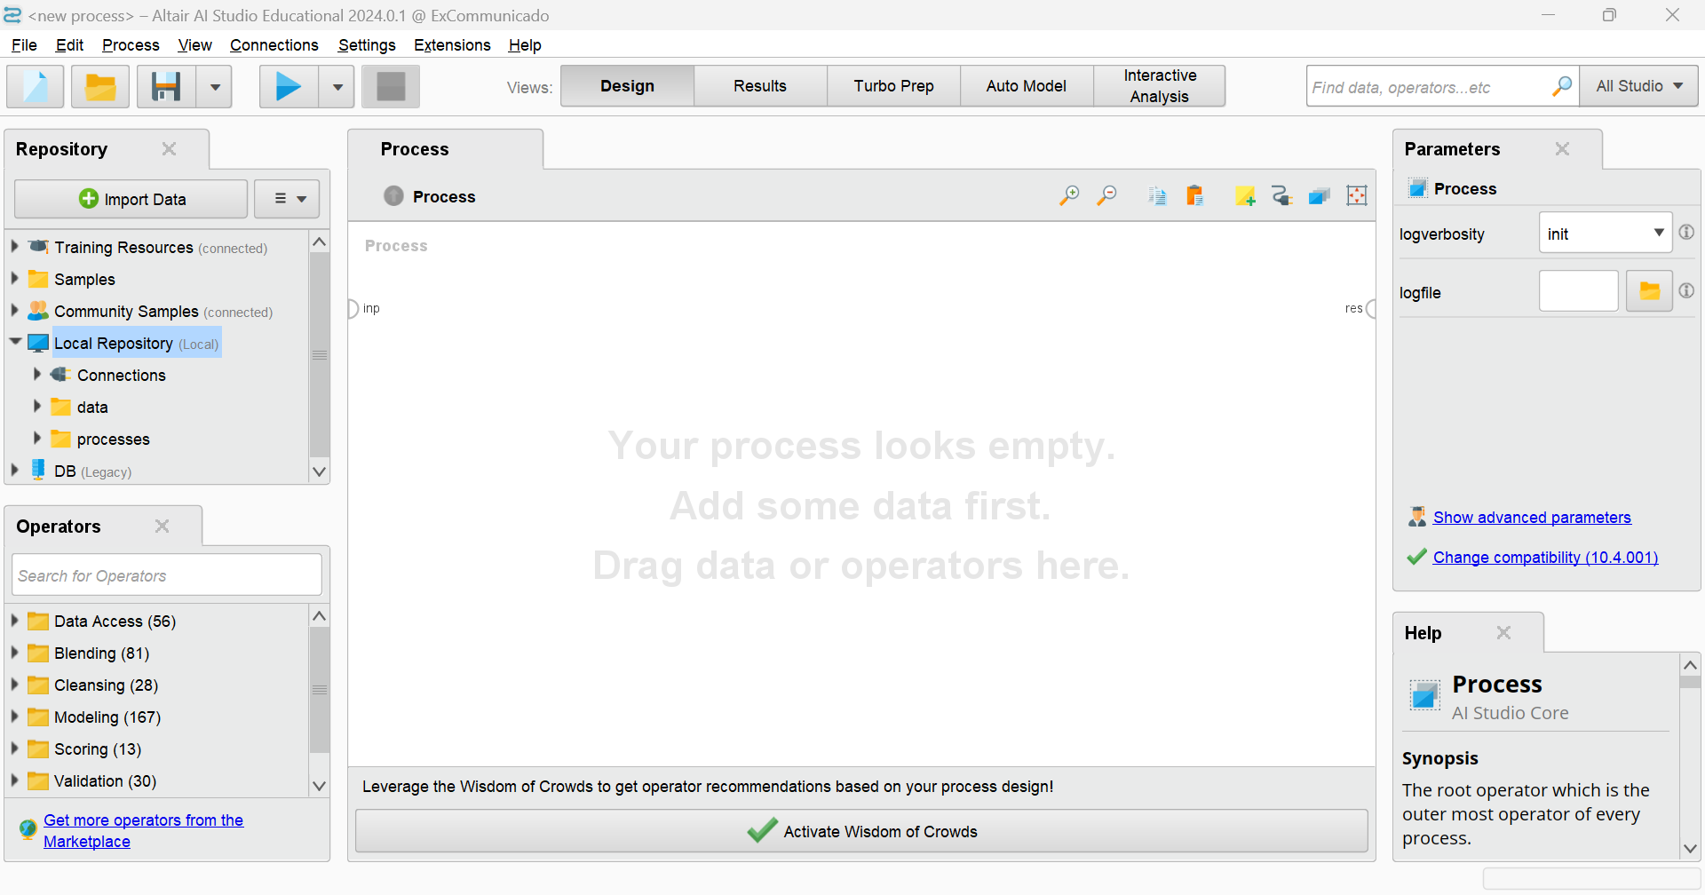
importing the data into rapidminer

Slide 11
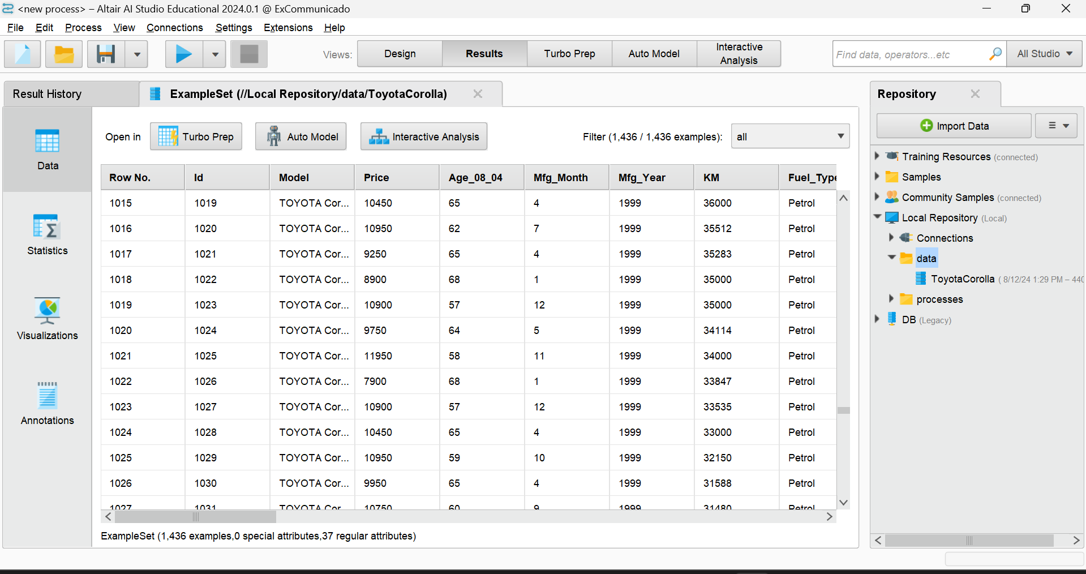
importing the data into rapidminer
After importing the data sets, it will look like (we are in the data section)

Slide 12
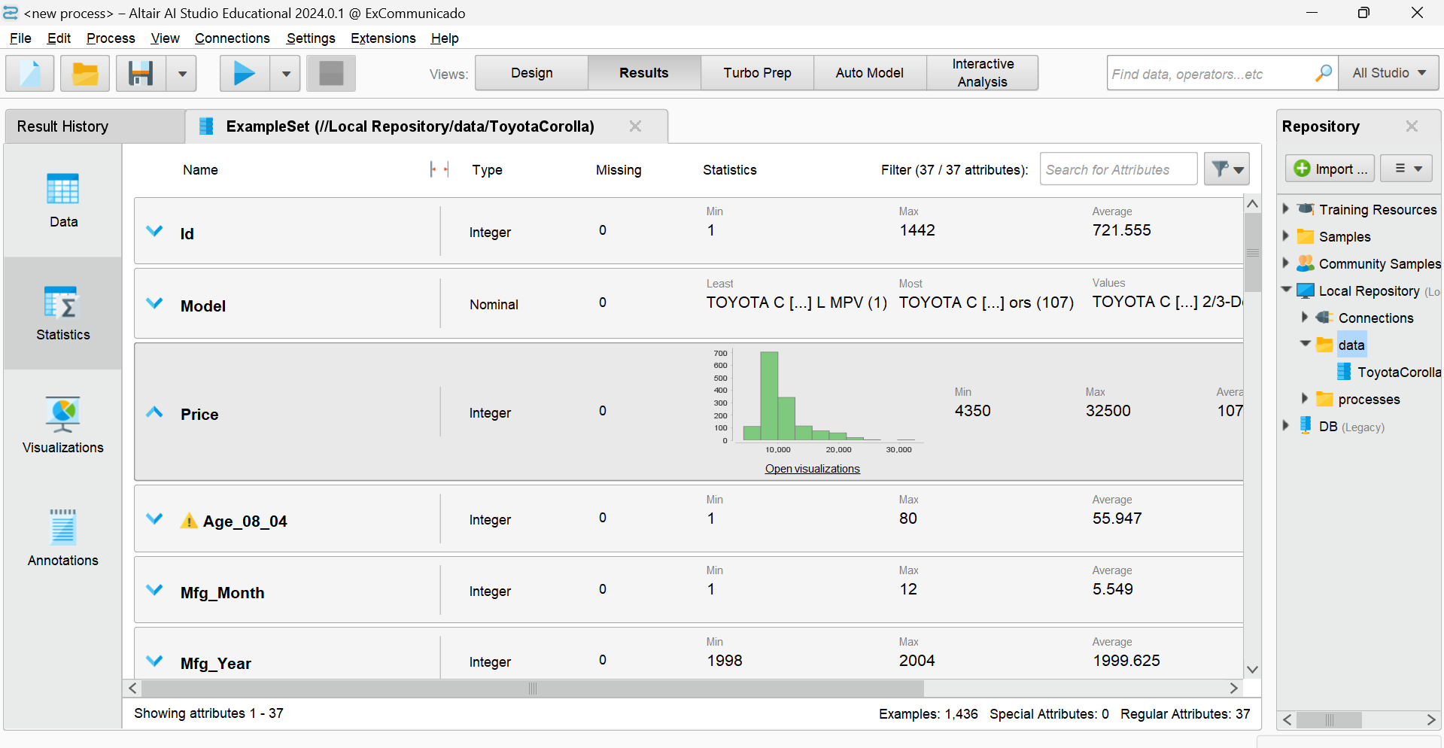
(DATASETS) Statistics section

Slide 13
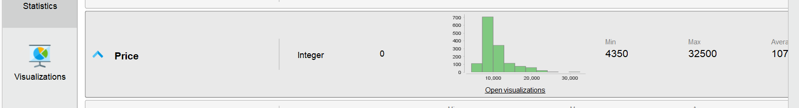
visualisation
Click on open visualization, you can see the visualization of the above table

Slide 14
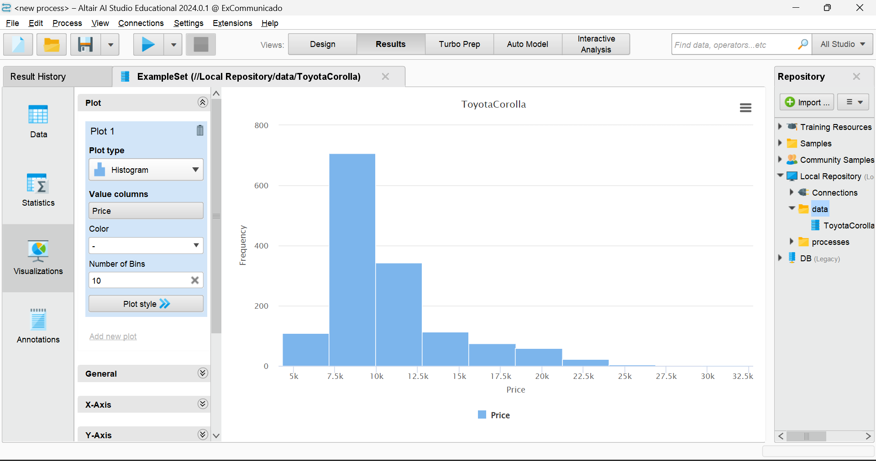
visualisation

Slide 15
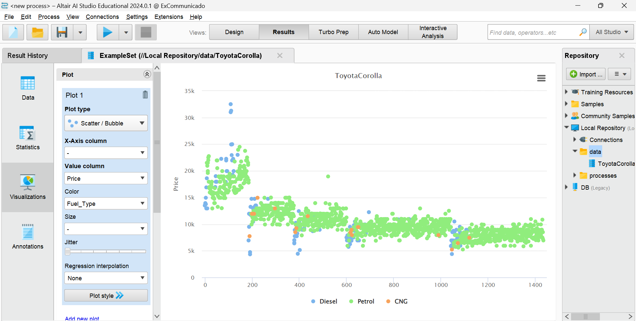
(Datasets) VISUALISATION SECTION

Slide 16
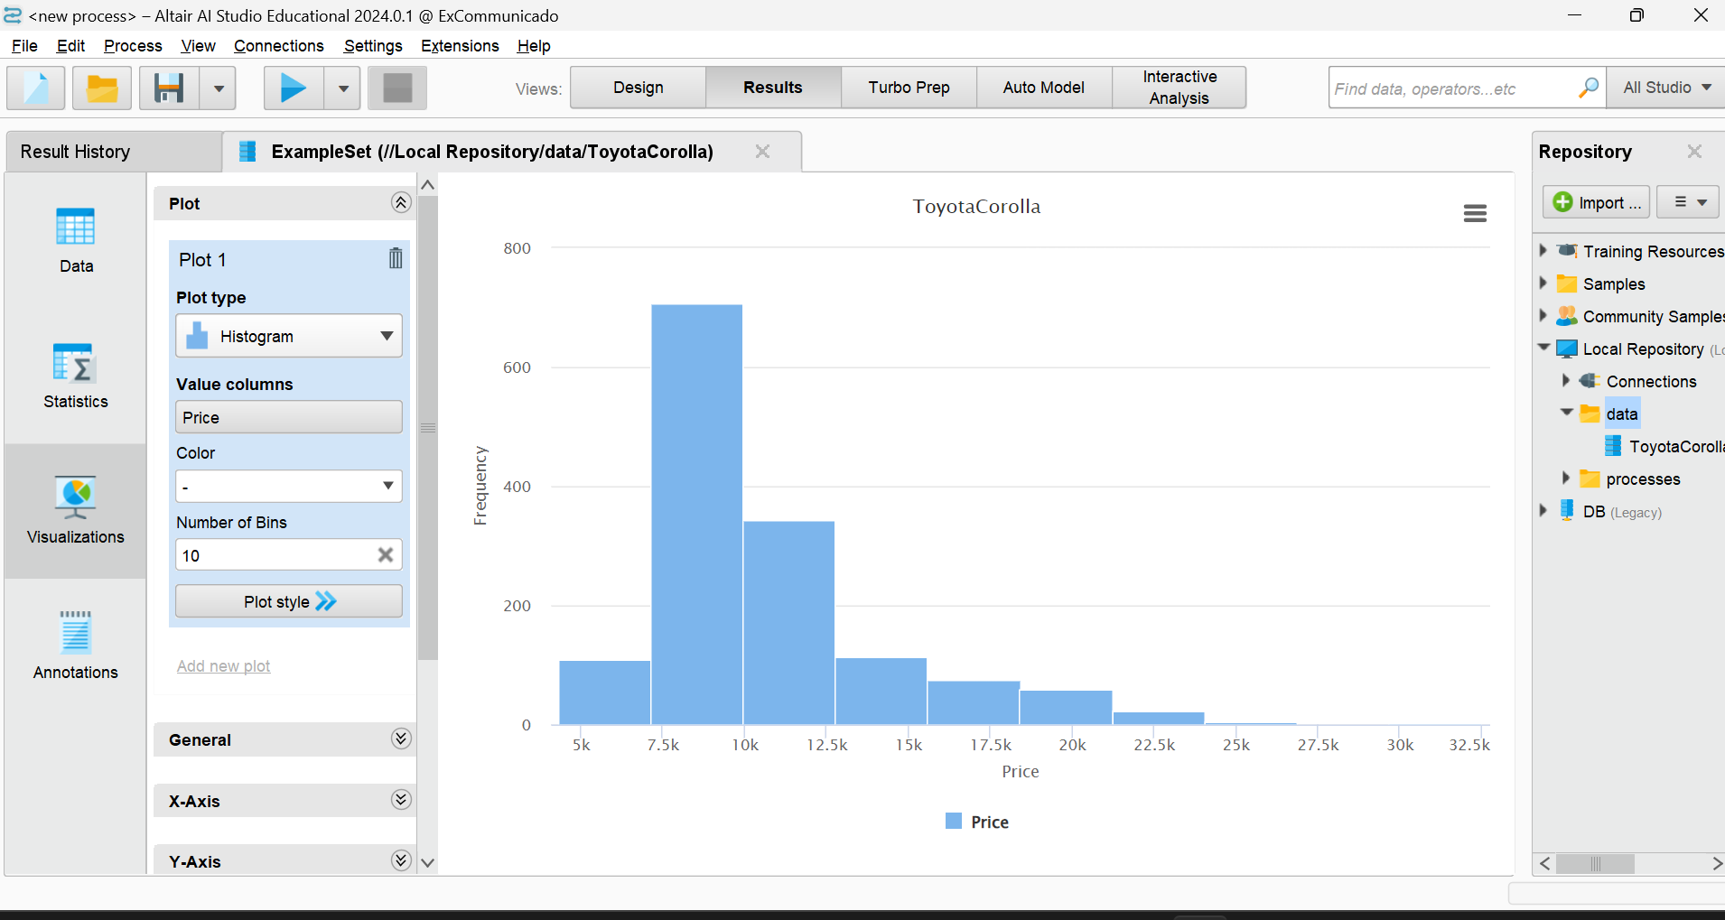
Building a process
Click here
Go here

Slide 17
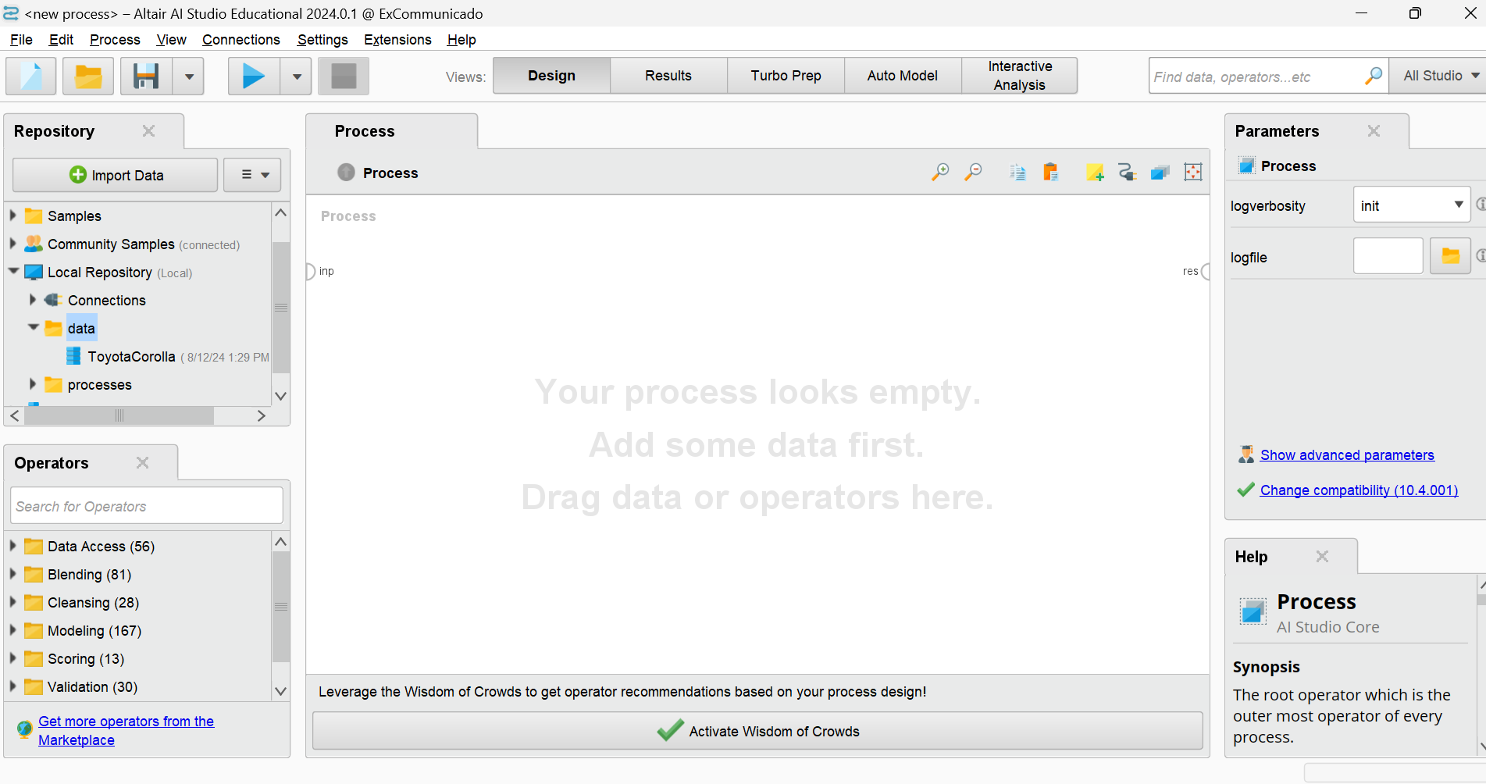
Building a SIMPLE process
DRAG this file to here

Slide 18
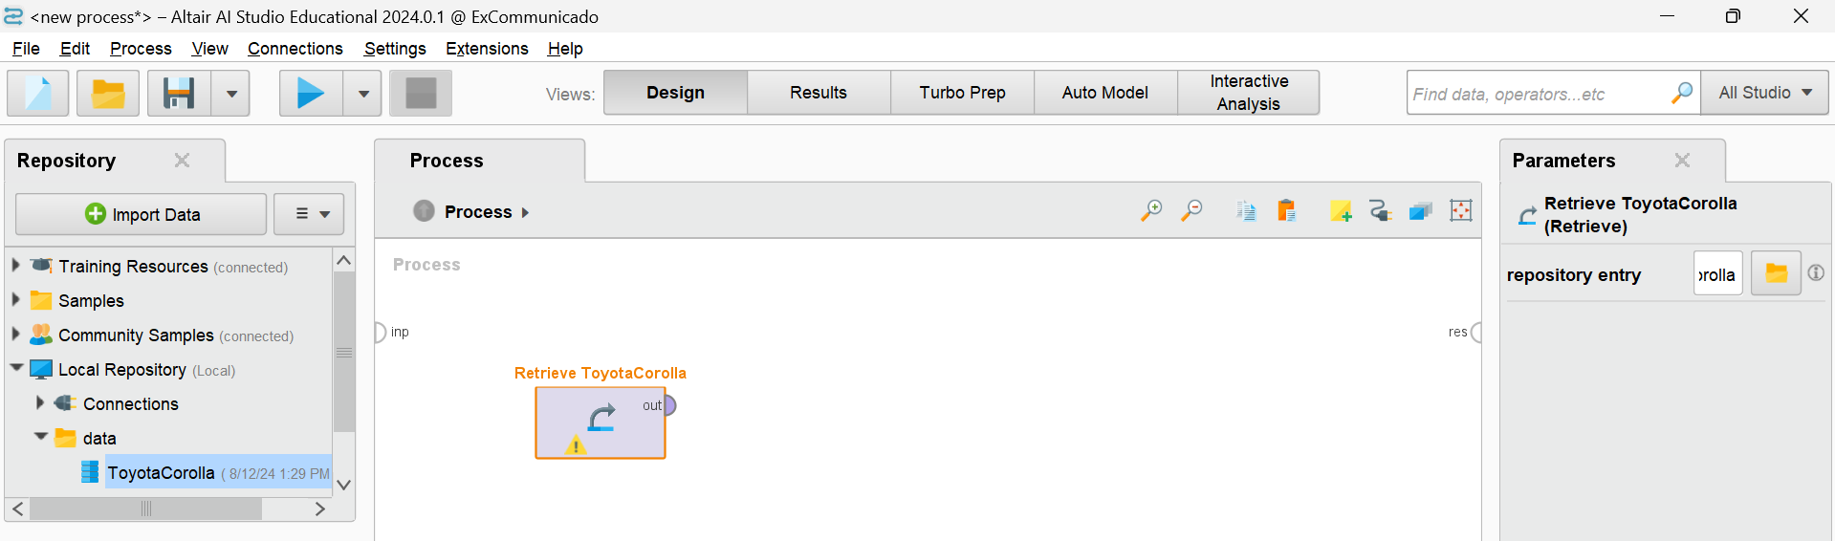

Building a SIMPLE process
below is how it looks like
You can see the out (output) and res (result) join that with by dragging after clicking out to the res and save it with any name and hit run (this is what we call a running a process)

Slide 19
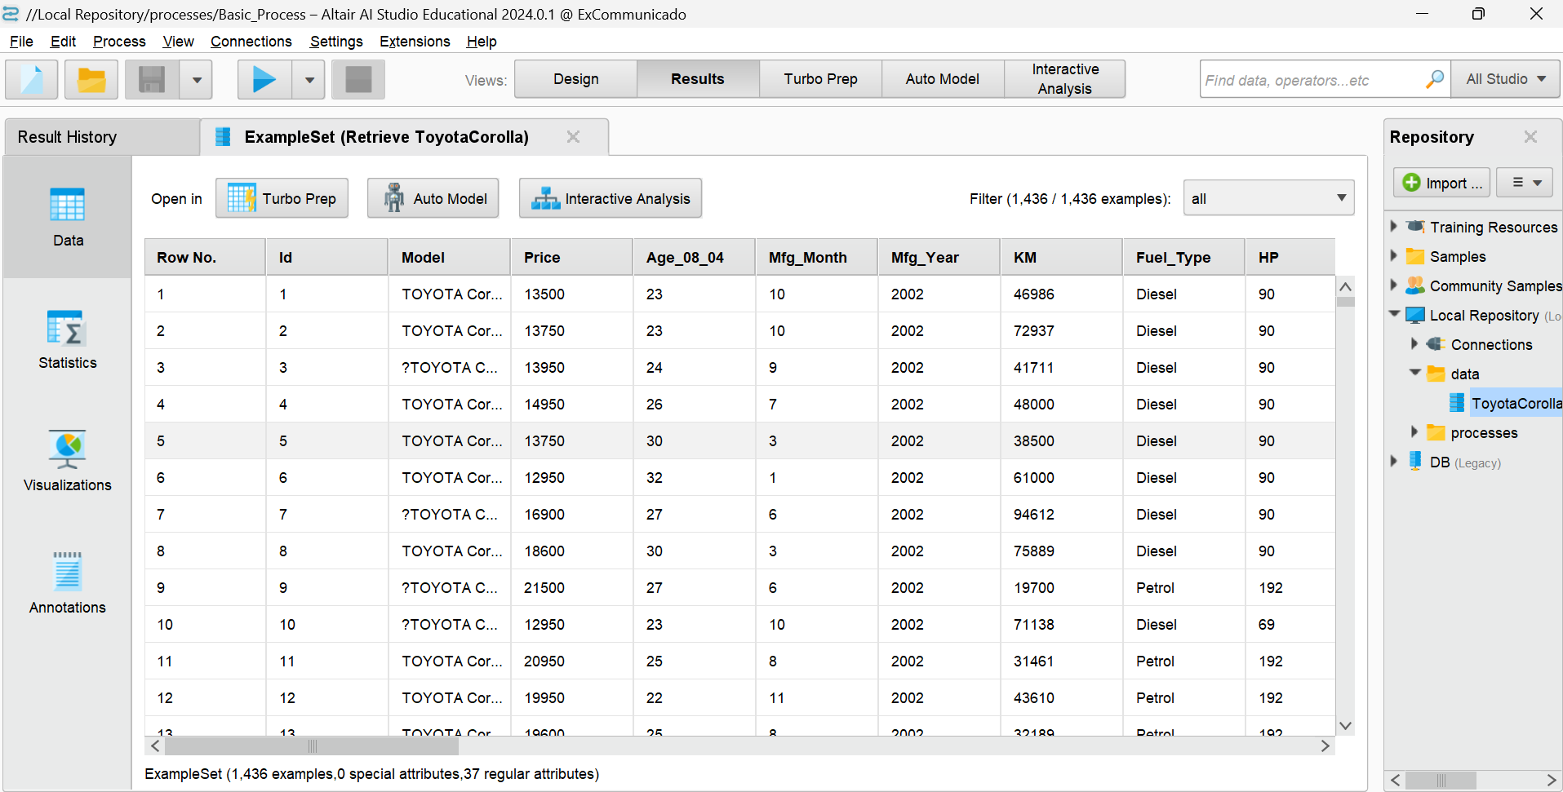
Building a SIMPLE process
After running, below is what we get

Slide 20
Correlation matrix Operator
This Operator determines correlation between all Attributes
It can produce a weights vector based on these correlations.
Correlation is a statistical technique that can show whether and how strongly pairs of Attributes are related.

Slide 21
Correlation matrix Operator
A Correlation Matrix is a table showing correlation coefficients between variables.
Each cell in the matrix shows the correlation between two variables
The value ranges from
-1 to 1:
+1: Perfect positive correlation
0: No correlation
-1: Perfect negative correlation

Slide 22
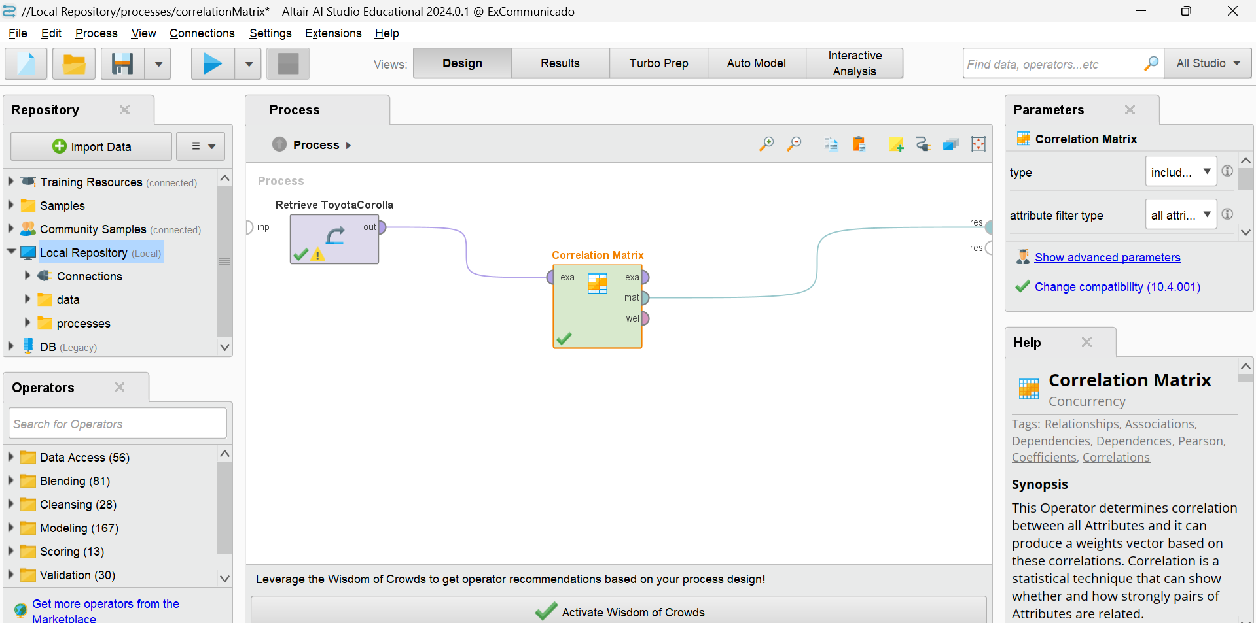
Correlation matrix process
Here it is:

Slide 23
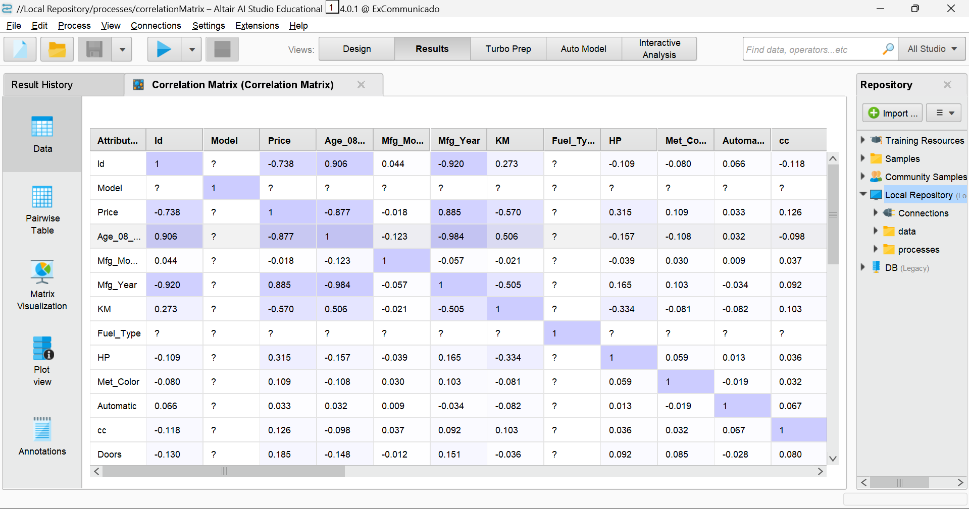
Correlation matrix process
After running the process:

Slide 24
Data aggregation
This operator performs the aggregation functions known from SQL.
This operator provides a lot of functionalities in the same format as provided by the SQL aggregation functions.
SQL aggregation functions and GROUP BY and HAVING clauses can be imitated using this operator.

Slide 25
Data aggregation
We will use the aggregate operator for the data aggregation.
Suppose we want to get the average price of the car group by fuel type
How to do this?

Slide 26
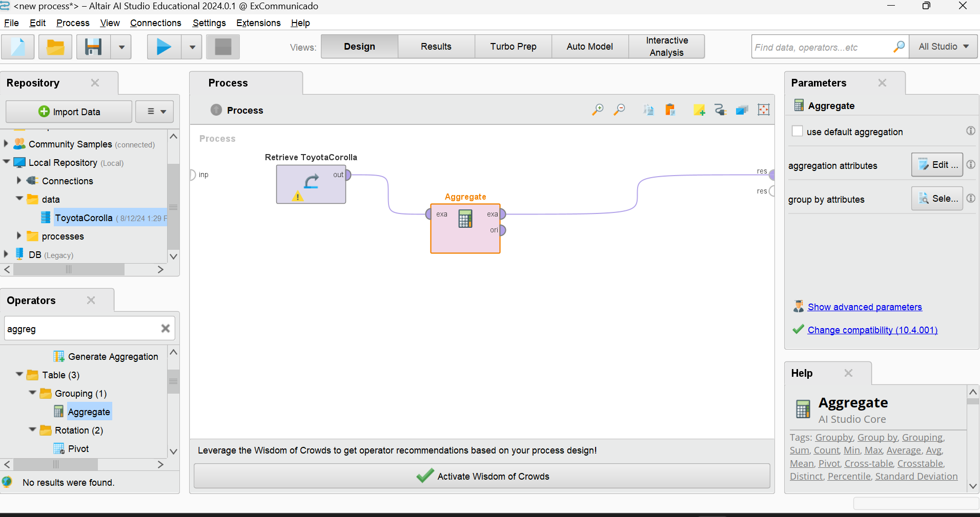
Data aggregation
This is the process :

Slide 27
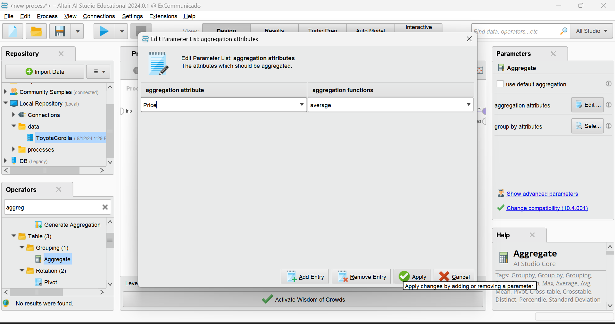
Data aggregation
To the right of the process set the parameter aggregation attribute like below and click apply

Slide 28
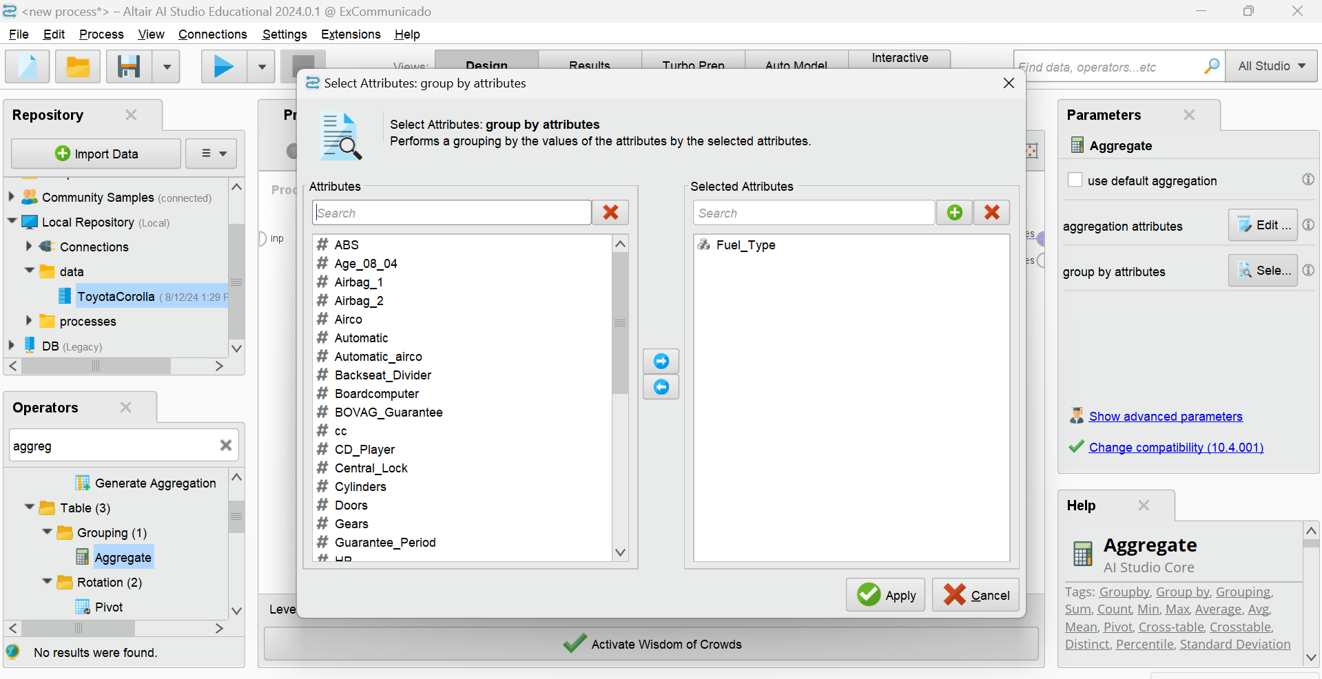
Data aggregation
Set the Group by to “fuel_type” click on fuel_type from the L.H.S and move it to the right using arrow button and click apply

Slide 29
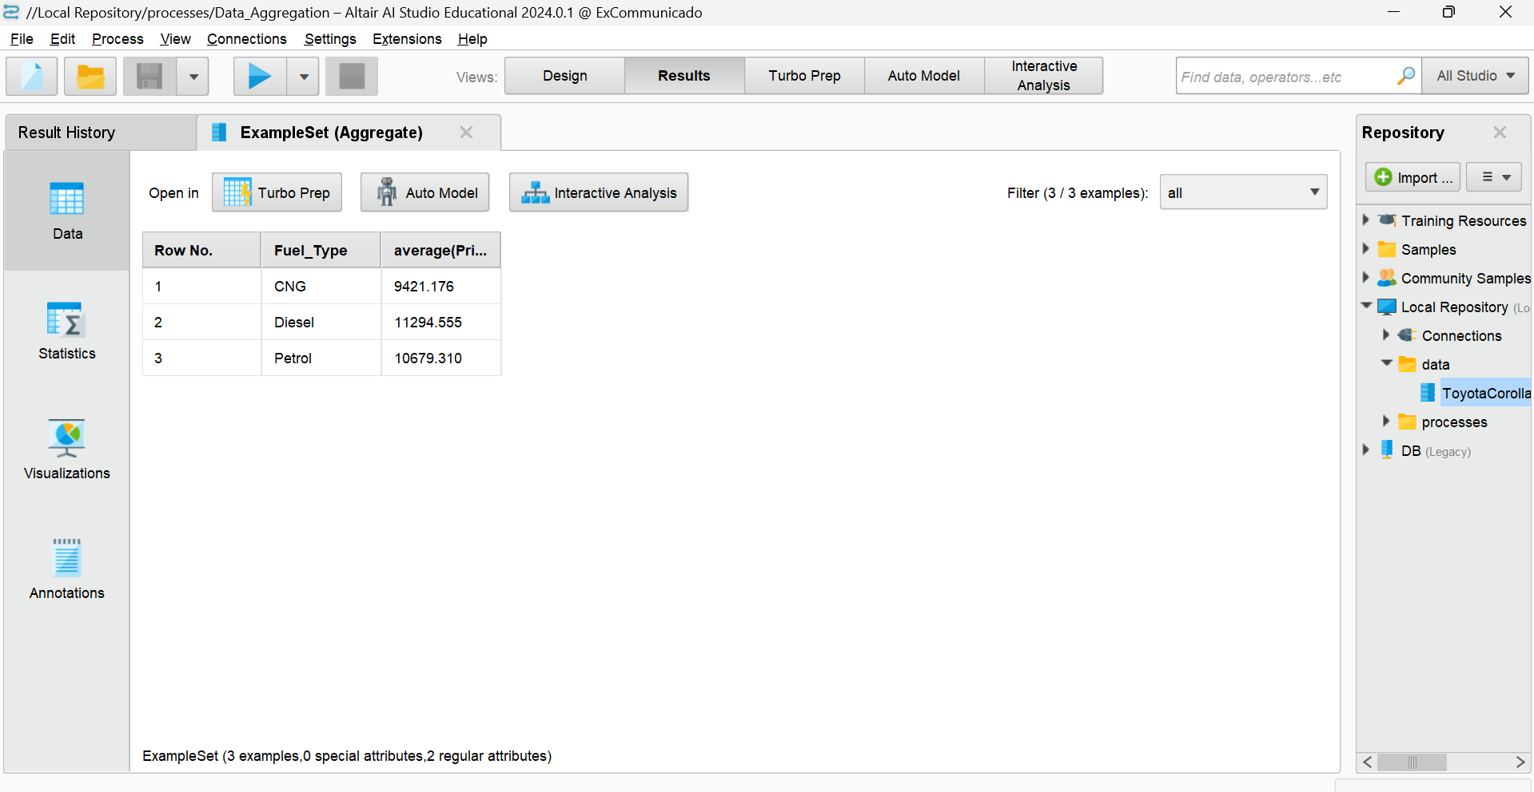
Data aggregation
Let’s save and RUN… below given is what we get after running the process..

Slide 30
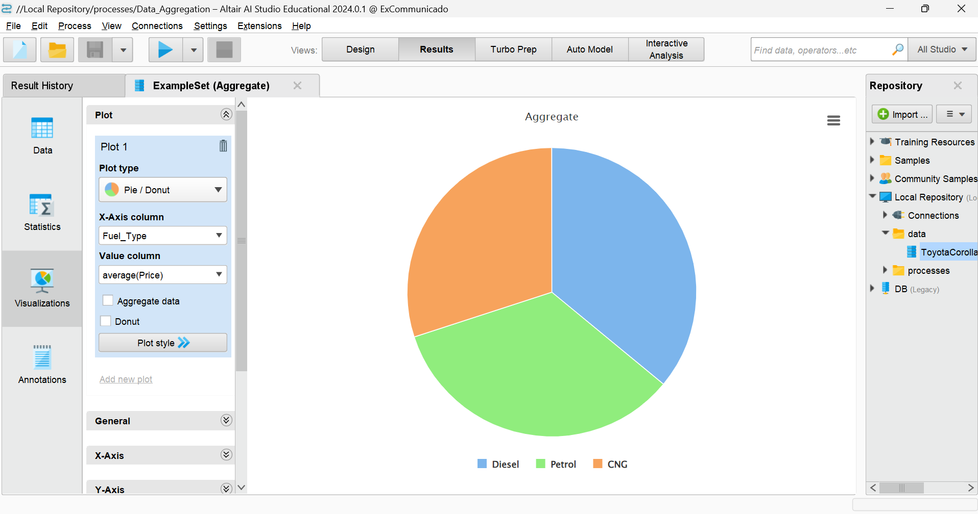
Data aggregation
Visualisation defaultly it chose a plot type “pie chart” you can change the plot type to anything by clicking the plot type dropdown

Slide 31
LINEAR REGRESSION
Linear Regression is a statistical method for modeling the relationship between a dependent variable (Y) and one or more independent variables (X).
It’s one of the simplest and most commonly used algorithms in Data Science.

Slide 32
LINEAR REGRESSION
Simple Linear Regression: Models the relationship between two variables by fitting a linear equation to the observed data.
Equation: Y=b0+b1X+ϵ
b0​: Intercept
b1​: Slope (how much Y changes for a unit change in X)
ϵ: Error term (difference between observed and predicted Y)
Multiple Linear Regression: Extends the model to include more than one independent variable.
Equation: Y=b0+b1X1+b2X2+...+bnXn+ϵ

Slide 33
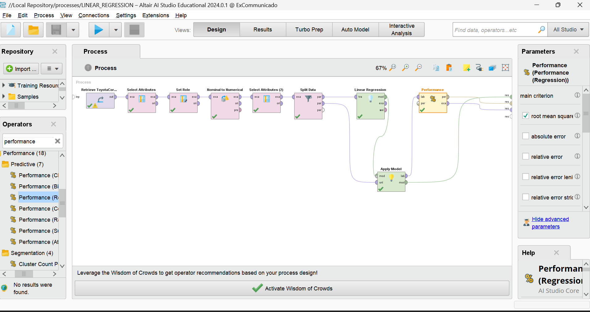
Linear regression
Process

Slide 34
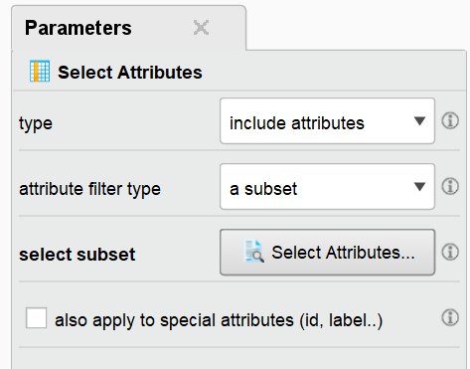
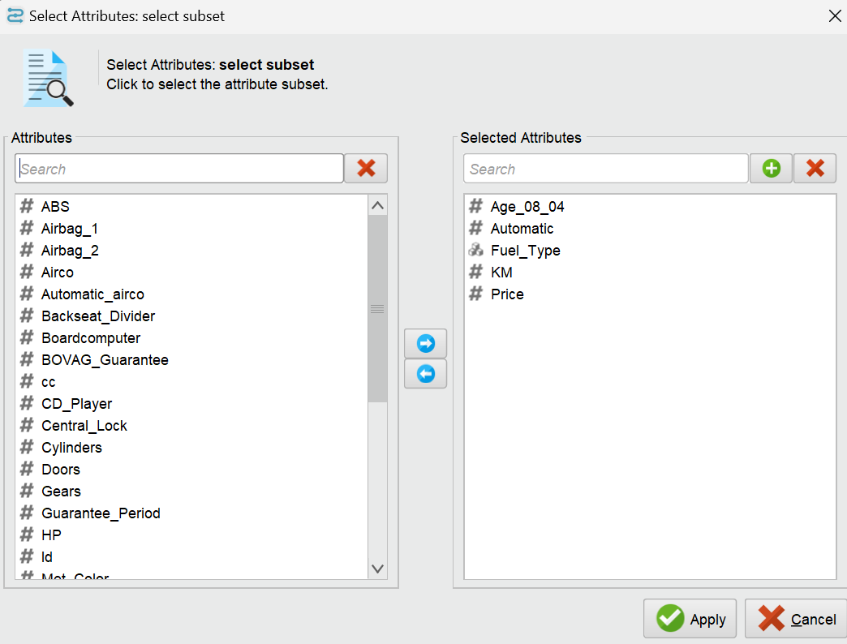
SELECT ATTRIBUTE OPERATOR
This Operator selects a subset of Attributes of an ExampleSet and removes the other Attributes
In the LINEAR REGRESSION PROCESS..select the below parameters

Slide 35
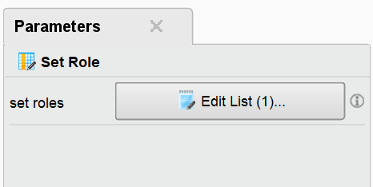
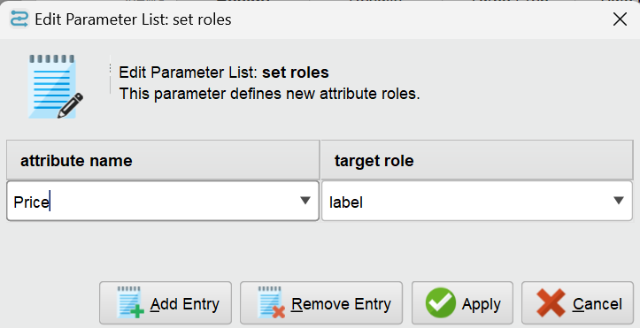
SET ROLE OPERATOR
This Operator is used to change the role of one or more Attributes.

Slide 36
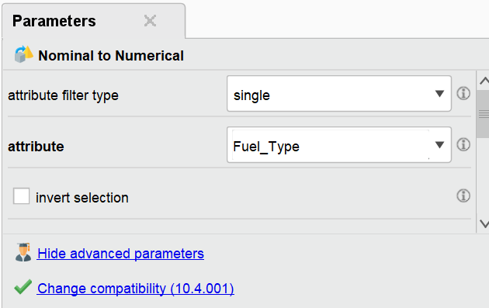
NOMINAL TO NUMERICAL OPERATOR
This operator changes the type of selected non-numeric attributes to a numeric type. It also maps all values of these attributes to numeric values.
Make changes in parameter like below

Slide 37
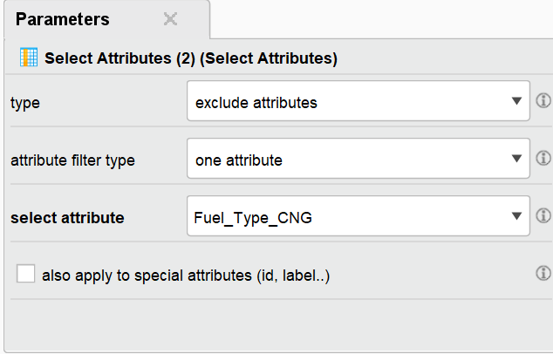
SELECT ATTRIBUTE OPERATOR
Second time when I used the select attribute , the parameter for that is

Slide 38
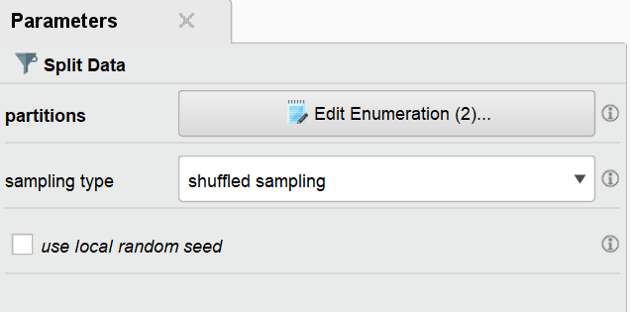
Split data operator
This operator produces the desired number of subsets of the given ExampleSet. The ExampleSet is partitioned into subsets according to the specified relative sizes.
The parameter for this looks like below

Slide 39
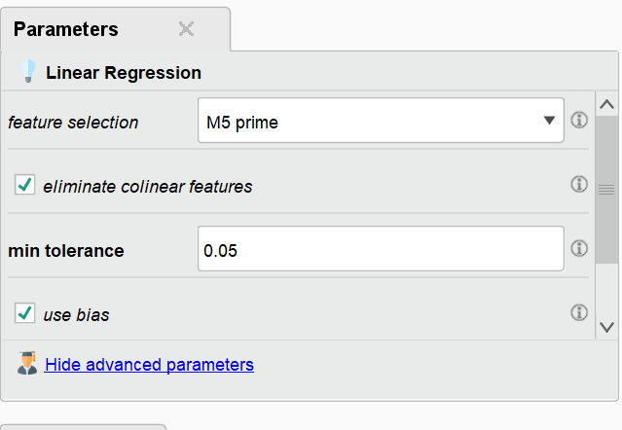
Linear Regression operator
This operator calculates a linear regression model from the input ExampleSet.
Didn’t make any changes in parameter. The default parameter which we used is

Slide 40
Apply Model operator
This Operator applies a model on an ExampleSet.
A model is first trained on an ExampleSet by another Operator, which is often a learning algorithm. Afterwards, this model can be applied on another ExampleSet. Usually, the goal is to get a prediction on unseen data or to transform data by applying a preprocessing model.
The ExampleSet upon which the model is applied, has to be compatible with the Attributes of the model. This means, that the ExampleSet has the same number, order, type and role of Attributes as the ExampleSet used to generate the model.

Slide 41
Performance regression operator
This operator is used for statistical performance evaluation of regression tasks and delivers a list of performance criteria values of the regression task.
This operator should be used for performance evaluation of regression tasks only
This input port expects a labeled ExampleSet.
The Apply Model operator is a good example of such operators that provide labeled data.
Make sure that the ExampleSet has the label and prediction attribute.

Slide 42
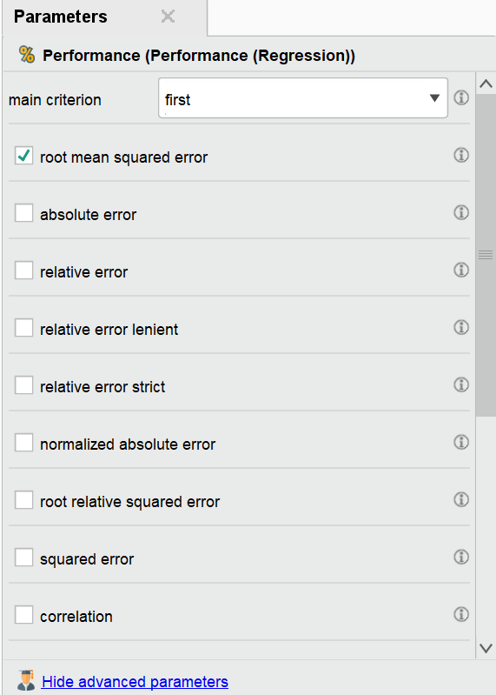
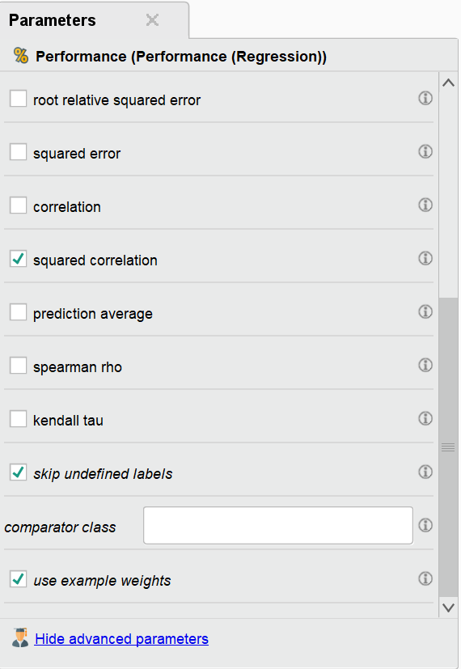
Performance regression operator
Make the below changes in the parameter of the above operator

Slide 43
Results
We will get three results here
ExampleSet (Apply Model)
PerformanceVector(Performance)
LinearRegression (Linear Regression)

Slide 44
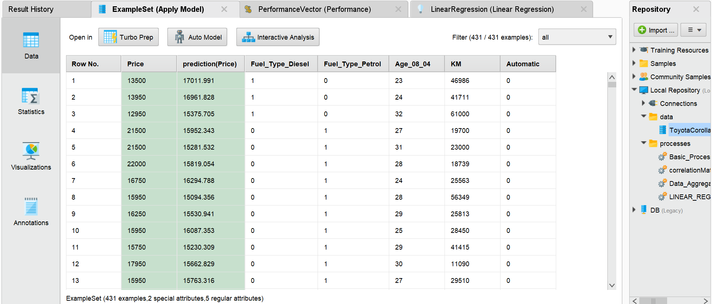
1. ExampleSet (Apply Model)
Data section

Slide 45
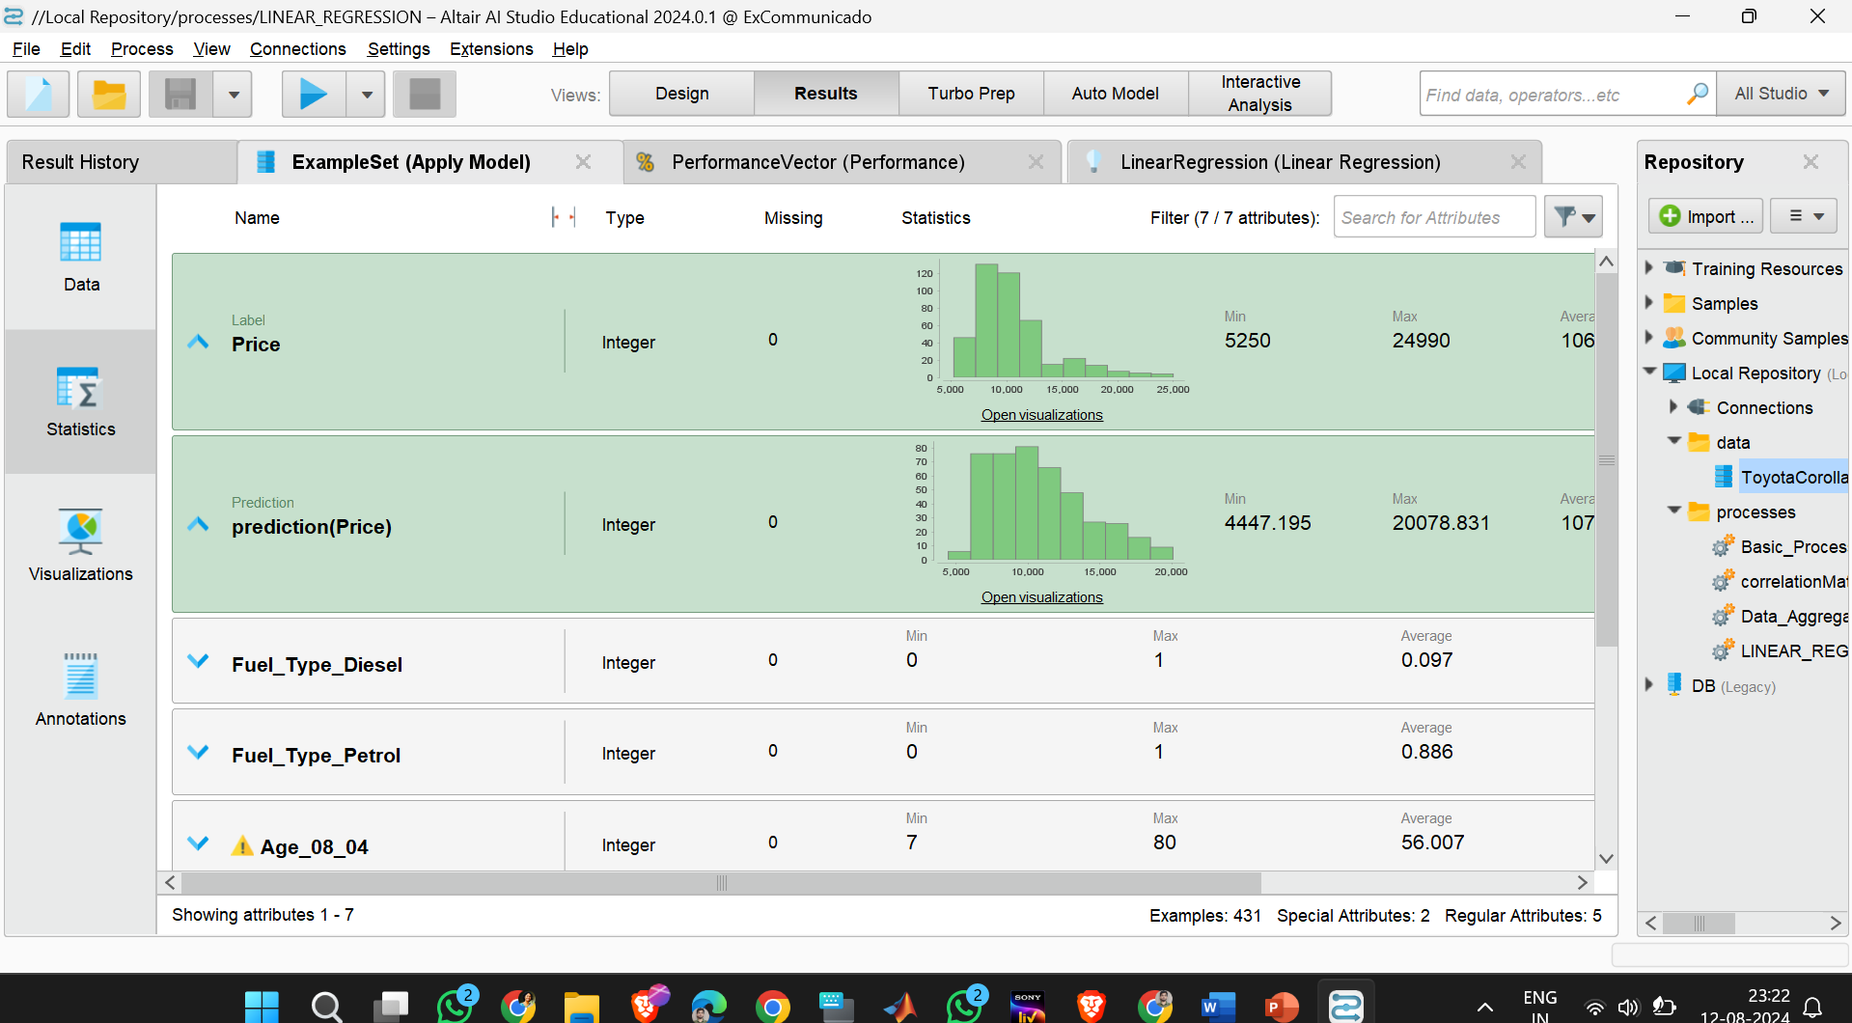
1. ExampleSet (Apply Model)
Statistics

Slide 46
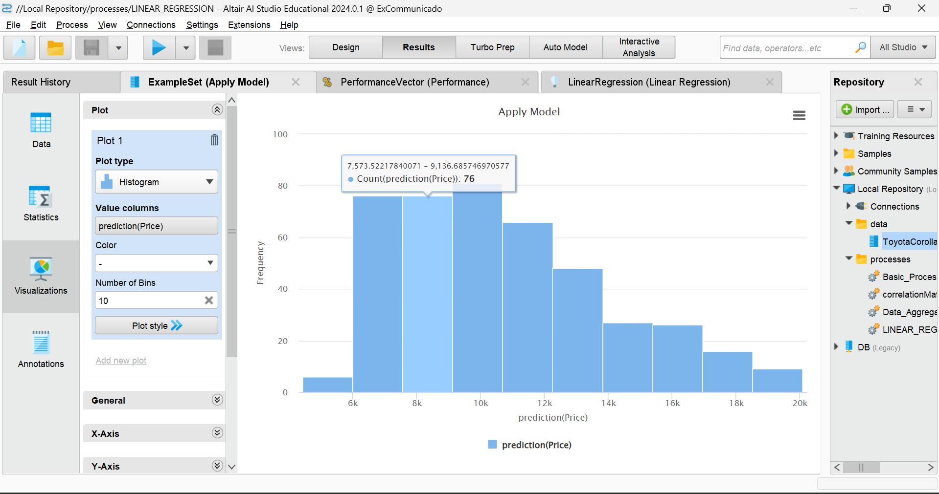
1. ExampleSet (Apply Model)
You can click on open visualisation to see the visualisation part
For example : for PREDICTION PRICE

Slide 47
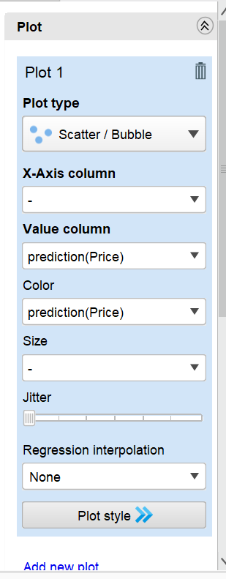
1. ExampleSet (Apply Model)
Made some changes like this and see the next slide for the output

Slide 48
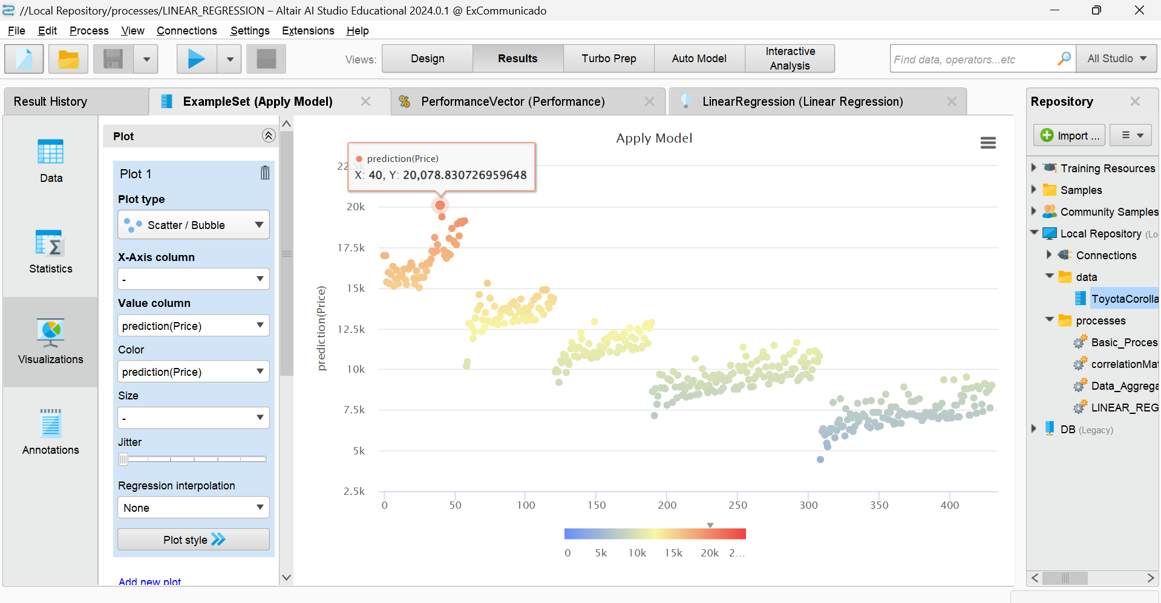
1. ExampleSet (Apply Model)
Visualisation section

Slide 49
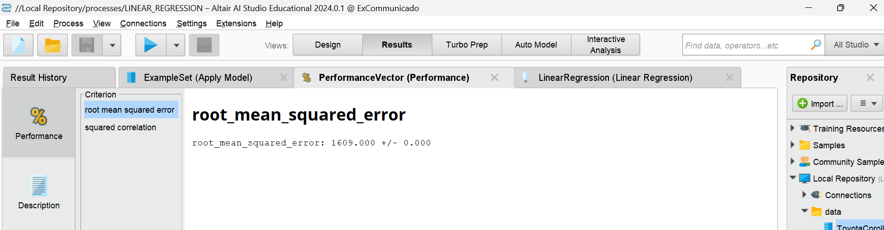
2.PERFORMANCE VECTOR (PERFORMANCE)
For root mean squared error

Slide 50
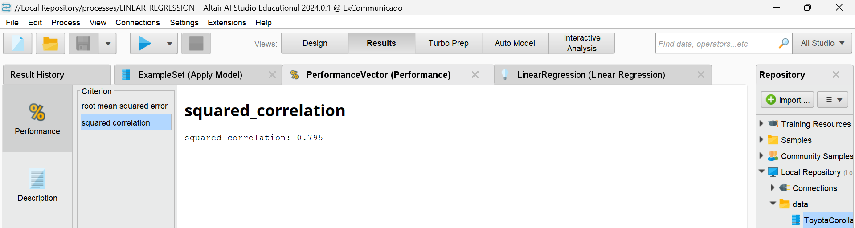
2.PERFORMANCE VECTOR (PERFORMANCE)
For squared relation

Slide 51
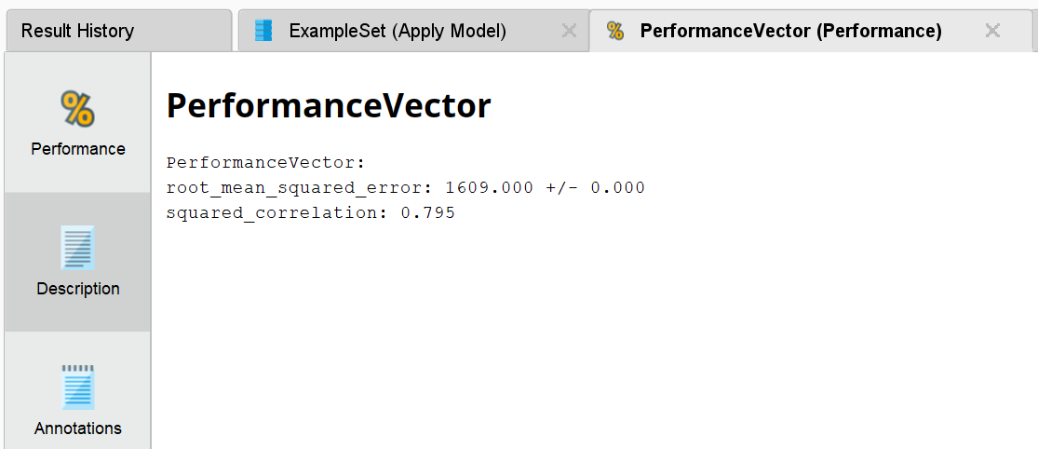
2.PERFORMANCE VECTOR (PERFORMANCE)
Description

Slide 52
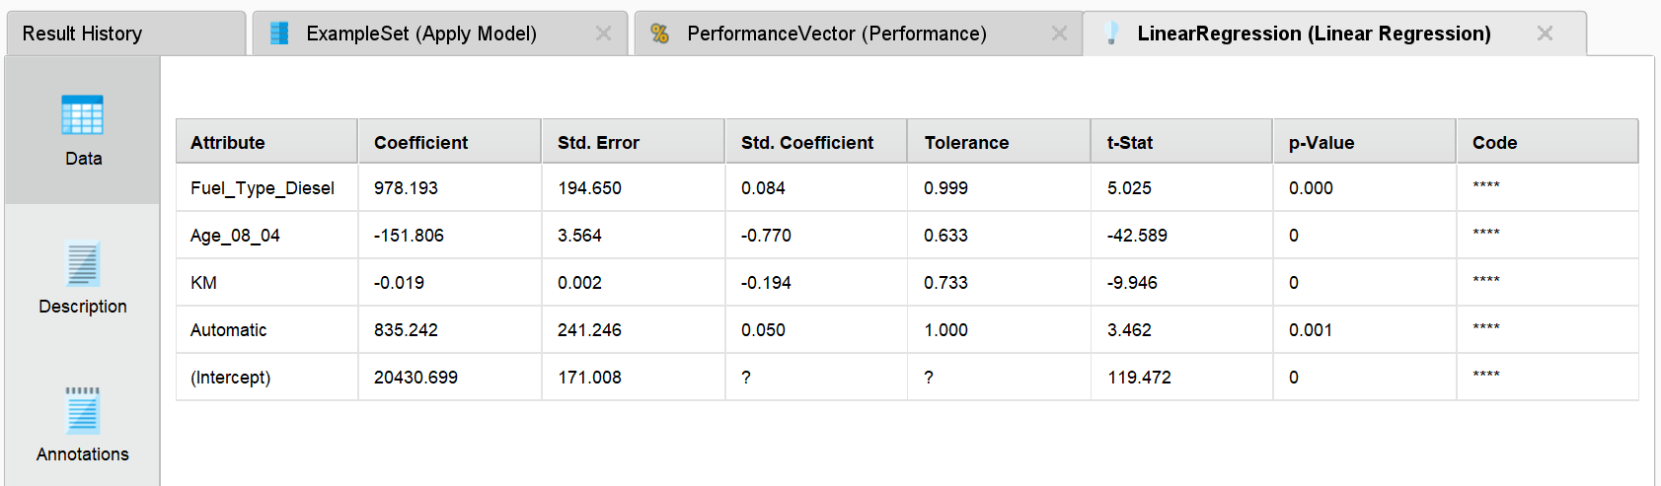
3.Linear regression (Linear regression)
Data section

Slide 53
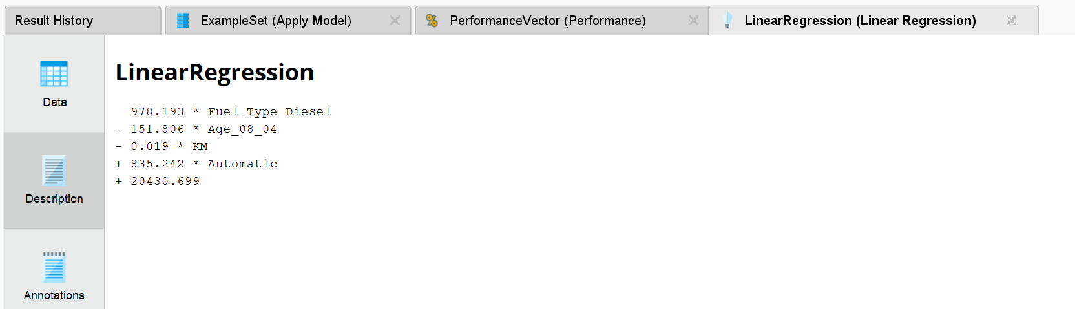
3.Linear regression (Linear regression)
Description section

Slide 54
conclusion
RapidMiner is a very easy tool to learn and expertise data science..
RapidMiner platform can be used for mastering Data Science , data engineering, data manipulating.
I have used the Rapidminer for importing the data, visualising the data, building a process, to get the correlation matrix from a data, Data aggregation and linear regression.

Slide 55


